Slide 1
Avoid the Tech Overload
Catherine McFarland
Spruce Creek High School
Email: crmcfarl@volusia.k12.fl.us - Twitter: @sramcfarland
www.sramcfarland.weebly.com/pd.html

Slide 2
Objective
Workshop participants will use 3 technological programs as a student. Participants will also be able to utilize these programs in their classrooms to engage their students.

Slide 3
Workshop Agenda
Google Maps activity
2 minutes of questions
Quizlet Live game
2 minutes of questions
Weebly showing
2 minutes of questions
Let’s Create!
Sharing

Slide 4
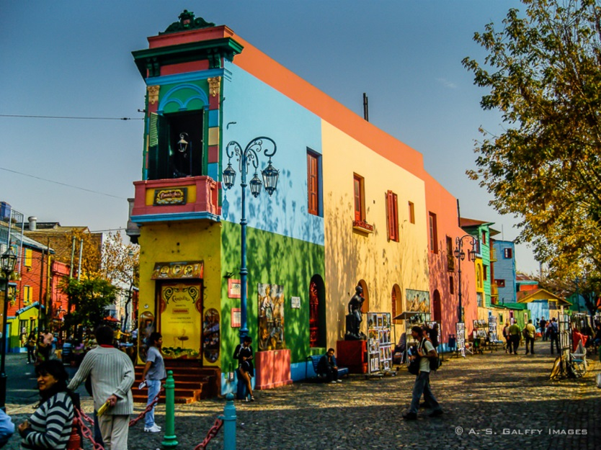
Google Maps
La Boca, Buenos Aires, Argentina
Fill out Part 1 (numbers 1-3) on the provided handout while going on a virtual field trip to La Boca, Buenos Aires, Argentina.

Slide 5
Google Maps-Homework
Using your device, go to Google.com/maps
Type in the search bar: La boca, Buenos Aires, Argentina (if it asks you to download the app, press X to close the notification)
Drag the bottom white box at the bottom of the screen up
Click on Photos
Use the arrows on the page to walk around the city and explore.
Answer the 4th question.

Slide 6
Teacher Google Maps
Search the city/destination
Be sure there is Street View
Explore!
How to video: tinyurl.com/hqcx7tw

Slide 7
2- Minutes of Questions
Remember- all questions can be answered during “Let’s Create” time!

Slide 8
Quizlet Live
Let’s review FFLA and Cultural Questions!

Slide 9
Quizlet Live- Teacher
How to use Quizlet Live:
tinyurl.com/jut9rlk
How to create a Quizlet:
tinyurl.com/jm3c4cj

Slide 10
2- Minutes of Questions
Remember- all questions can be answered during “Let’s Create” time!

Slide 11
Weebly

Slide 12
Weebly
Go to www.sramcfarland.weebly.com
Click on PD.

Slide 13
Weebly-Teacher
For what reason will you use a Class Website?
Be clear and organized
How to video: tinyurl.com/ja87efz

Slide 14
2- Minutes of Questions
Remember- all questions can be answered during “Let’s Create” time!

Slide 15
Let’s create!
Your turn to practice. Take this time to create/work with one of these programs.
We will share at the end of the workshop.

