Slide 1
Flipped Classroom
Catherine McFarland
@SraMcFarland

Slide 2
Agenda- 2:30-4
About Me (Ms. McFarland) and My “Why”
Flipped Classroom Simulation
Tips for flipped
Logistics of Flipping
27 Way to Flip a Class
Technology
Try it on your own!

Slide 3
Welcome!
About Me:
Sra. McFarland/Spruce Creek High School/Pre-IB 1 and IB 4-B
Why I started flipping?
Why I stuck with flipping?
What I’m improving for my class?

Slide 4
Learning Goals
During this workshop participants will learn how to flip a lesson. As such, you will be able to:
Experience a flipped classroom firsthand.
Learn how to flip a lesson by:
Determining the main content and goals of your lesson.
Determining which lesson activities can be done outside of class and which can be done during class.
Learning resources for your activities and content.
Acquiring information about class website for flipping.

Slide 5
Introduction to the Flipped Classroom Demo Outside of Class
Pretend that you are students who are going to fully participate in the flipped classroom format.
You are currently out of class, perhaps in study hall, in a coffee shop, in the media center, or at home, getting ready to do your flipped class homework.
You turn on your laptop or some other mobile device and access the class website.
(for this workshop, Ms.
McFarland will show video)

Slide 6
Introduction to the Flipped Classroom Outside of Class
On the course website you read the following directions:
To Prepare for Today’s Class, Do the Following:
View the following video: http://youtu.be/ojiebVw8O0g (Approximate length: 3 minutes)
Checking for Understanding – Flipped Classroom
While viewing the above video, fill out the provided homework sheet.
You will be expected to turn in this note sheet for a grade.
When you return to class, you will also be expected to answer comprehension questions on the video content.

Slide 7
Introduction to the Flipped Classroom In Class (Next Class Session)
Checking for Understanding Activity: Kahoot
Rest of the class activities, which will largely consist of the application of the material learned prior of class.

Slide 8
Write with clarity.
Use graphics to enhance students’ comprehension and to make information more aesthetically pleasing.
Be okay with a LOT of trial and error.
Ask your students for feedback.
Have fun and be playful.
Think outside of the box. Ask yourself, “What’s the coolest and most effective way(s) to teach this material?”
Include real-life activities as much as possible.

Slide 9
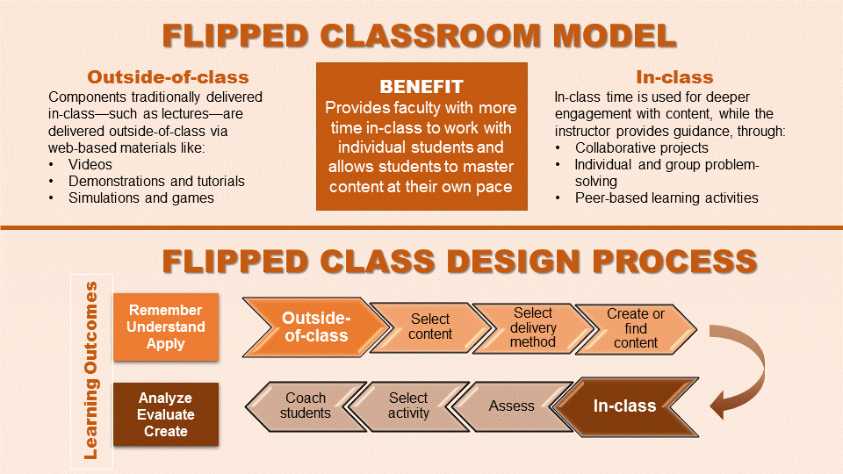
Logistics of Flipping – How Do I Flip?
Look over your lesson and determine the content and goals.
Determine the activities (both inside and outside of class) necessary for students to attain the goals. You may certainly use some of your current activities.
Look over your activities and determine which activities can be done outside of class and which can be done inside of class.
Find the necessary resources for your activities and content.

Slide 10
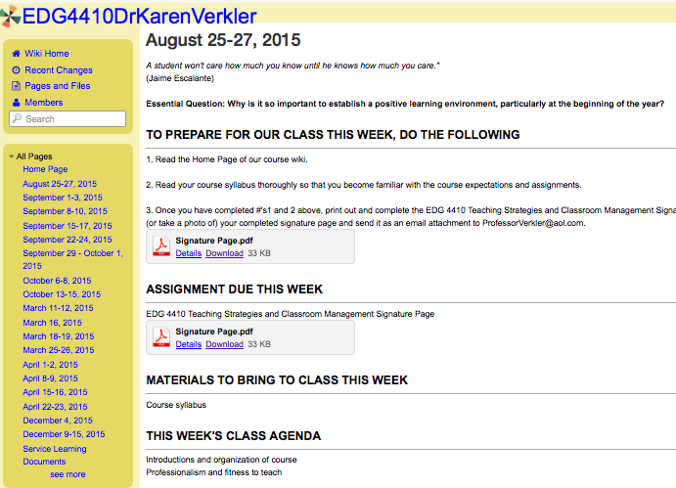
Logistics of Flipping – How Do I Flip?
Decide how you want to set up your website for flipping.
Place the content and activities into the format of your website.

Slide 12
Technological Resources

Slide 13
How to make a video?
iMovie
Knowmia
Screencast-O-Matic

Slide 14
iMovie
Free on iphone or ipad
Records you while teaching
Ability to add text, music, pictures, and edit the video.
Regular Present Tense Verb Video

Slide 15
Knowmia -$10 on tablet/iPad -Allows teacher to record themselves while explaining a slideshow. -The recording is interactive and editable.
Ser vs Estar Video

Slide 16
Screencast-O-Matic
Free on computer
Records your computer screen and voice.
Ability to video record with paid version.
Participio y Presente Perfecto

Slide 17
Where to post your videos?
Weebly
Edmodo
Blendspace

Slide 18
-Program that allows you to easily create a website.
-Has a free and paid option.
Sra. Mora’s Website

Slide 19
-Free program
-Allows you and your students to post information on one platform.
-Option to respond to the post and interact with each other.
Edmodo Page

Slide 20
-Free online
-Allows you to put all online resources in one area and monitor student assessment with immediate feedback.
-Students can post questions and respond to each other.
Formal Commands

Slide 21
How can I be sure that students are watching/ understanding the video?
Edpuzzle
Educanon

Slide 22
Educanon/ Edpuzzle -Free on a computer -Teachers upload a video to website and create comprehension questions for students to answer before continuing to watch the video.
Time Video

Slide 23
What can help with flipped classrooms?
Flipped 2.0 by Jason Bretzmann
Flip Your Classroom by Jonathan Bergmann
Flippedclassroom.org

Slide 24
Sharing Time:
What are some of the activities you wish you had more time for during class?
What are some engaging activities you’ve assigned for outside of class?

