Slide 1
Las tareas domésticas Chores around the house

Slide 2
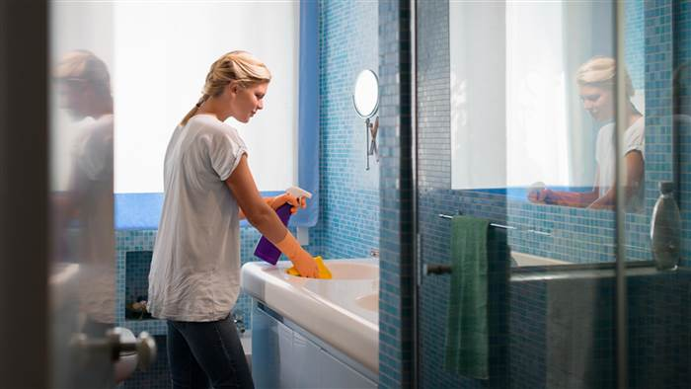
Limpiar el baño
To clean the bathroom

Slide 3
Ordenar la casa
To straighten up the house

Slide 4
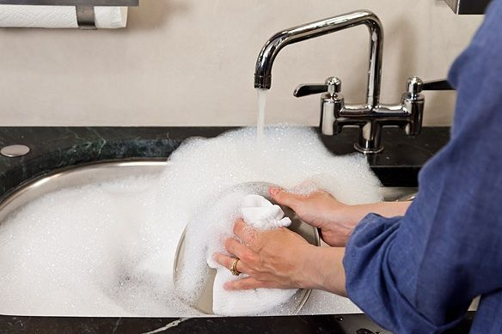
Lavar los platos
To wash the dishes

Slide 5
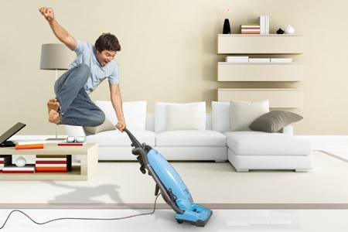
Pasar la aspiradora
To vacuum

Slide 6
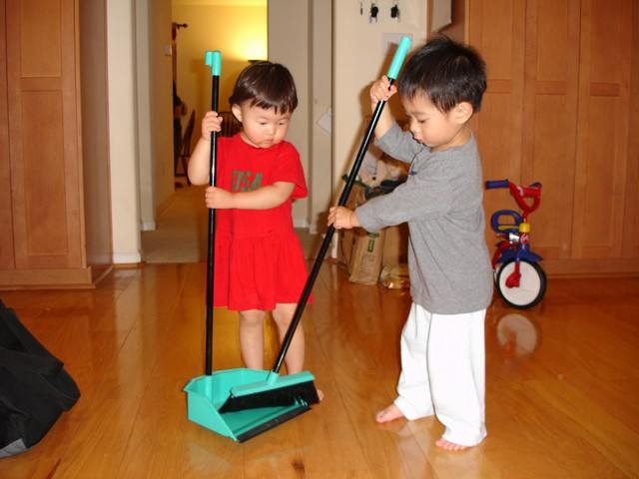
Barrer el suelo
To sweep the floor

Slide 7
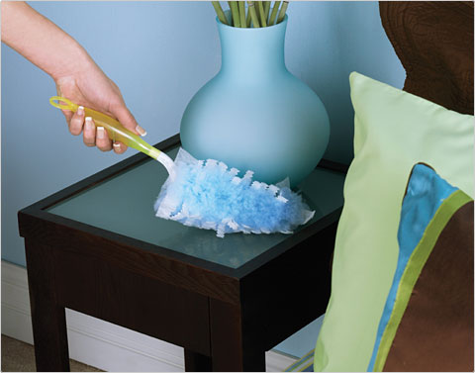
Sacudir los muebles
To dust the furniture

Slide 8
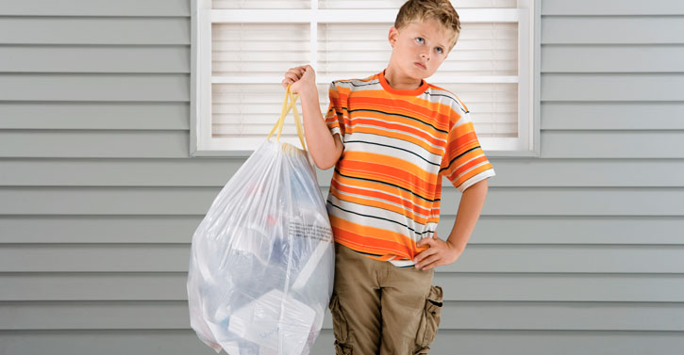
Sacar la basura
To take out the trash

Slide 9
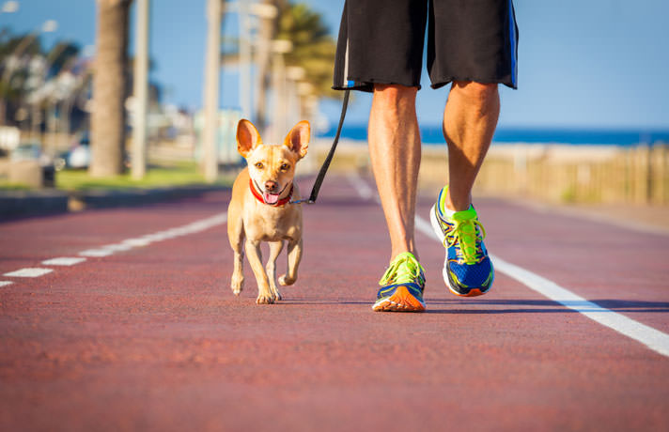
Pasear al perro
To walk the dog

Slide 10
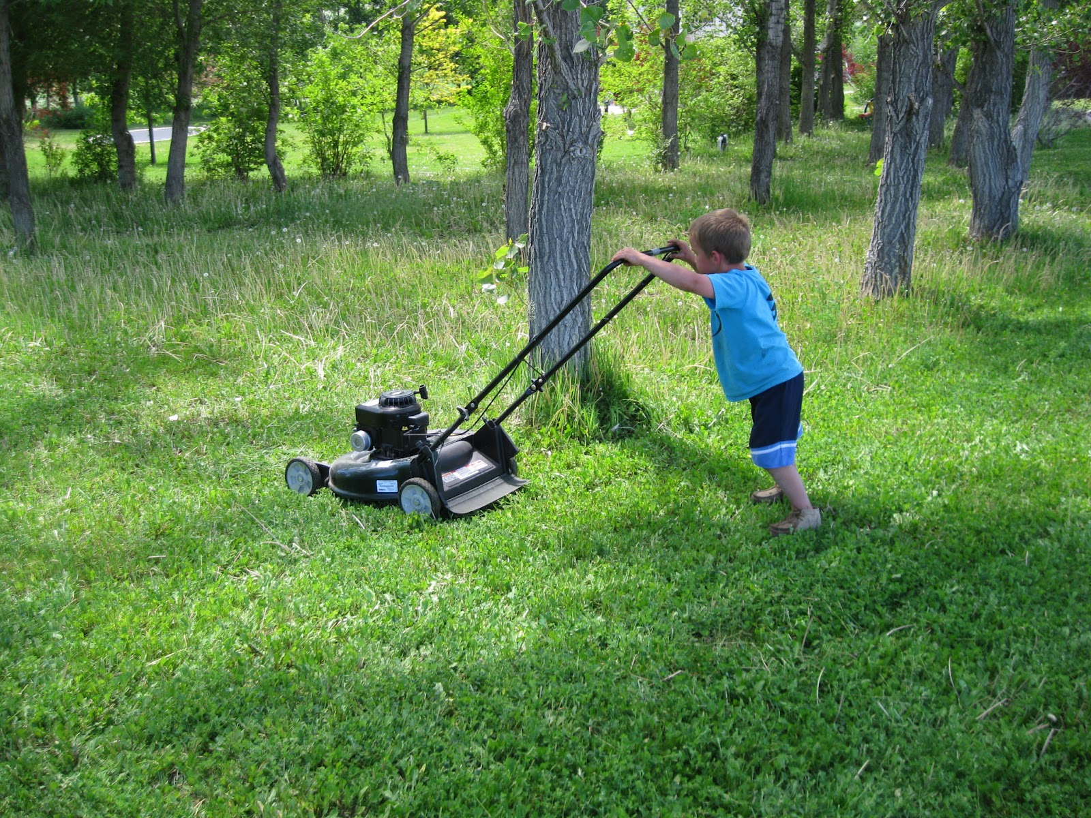
Cortar el césped
To cut the grass

Slide 11
Acciones habituales en la casa
Common actions in the house

Slide 12
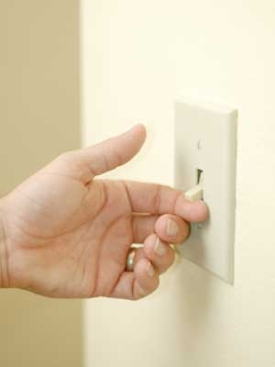
Prender la luz
To turn on the light

Slide 13
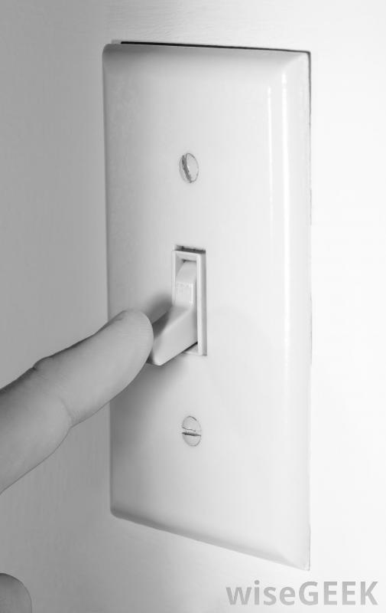
Apagar la luz
To turn off the light

Slide 14
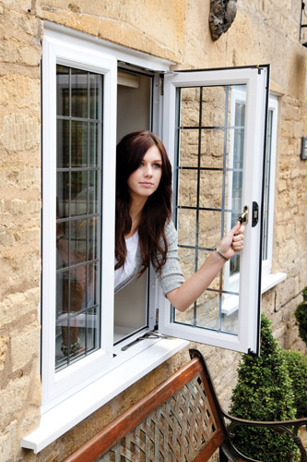
Abrir la ventana
To open the window

