Slide 1
Verbos pronomiales reflexivos y reciprocos

Slide 2
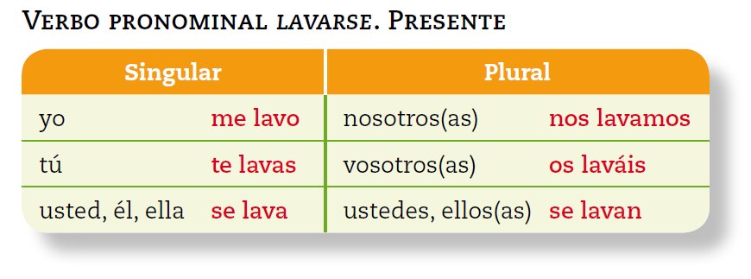
Reflexives - when an action reflects back on the subject. -Equivalent to myself, yourself, himself, etc.

Slide 3
Pronominal verbs express reciprocal actions
Each other, one another, etc.
This is always in the plural form and are conjugated like reflexive verbs.

Slide 4
Abrazar
To hug

Slide 5
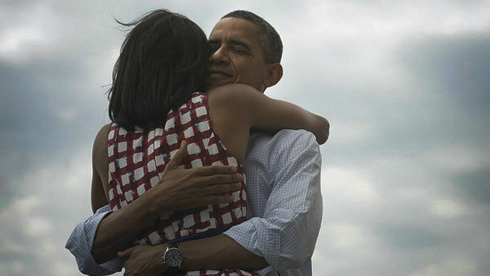
Abrazarse
To hug each other.

Slide 6
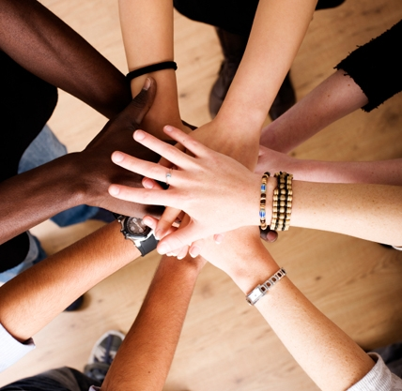
Apoyarse
To support eachother

Slide 7
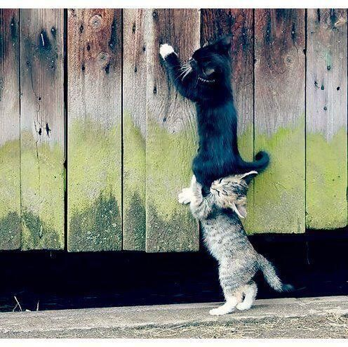
Ayudarse
To help each other

Slide 8
conocerse
To know each other

Slide 9
contarse
To tell each other

Slide 10
entenderse
To understand one another

Slide 11
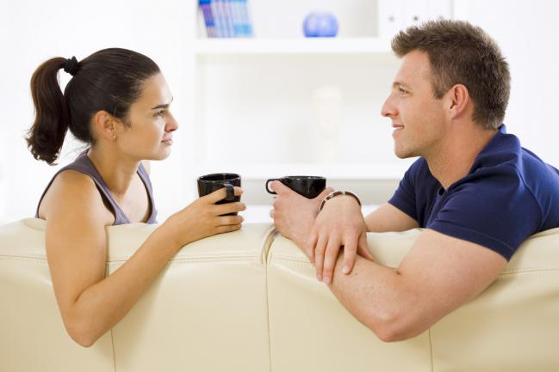
hablarse
To talk to each other

Slide 12
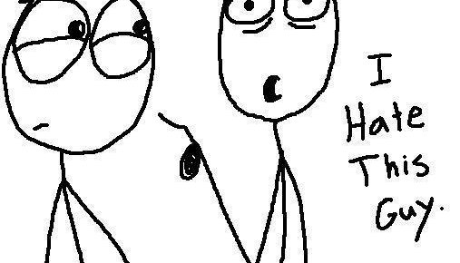
odiarse
To hate each other

Slide 13
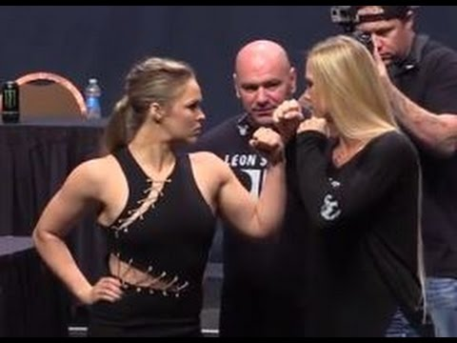
pelearse
To fight each other

Slide 14
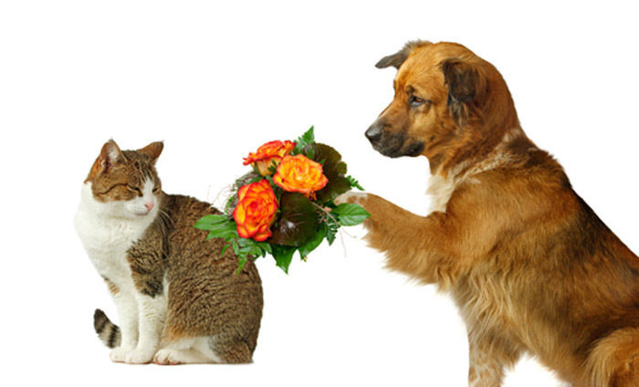
perdonarse
To forgive each other

Slide 15
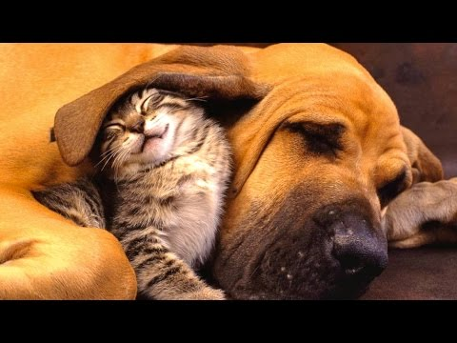
quererse
To love each other

Slide 16
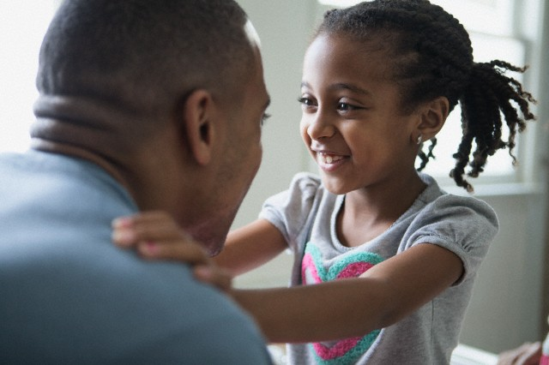
verse
To see one another

