Slide 1
Tech Tools Every Teacher Needs World Languages Professional Learning Day December 5th, 2016
Catherine McFarland
Spruce Creek High School
Spanish Teacher
Twitter: @SraMcFarland
This presentation: www.sramcfarland.weebly.com/pd.html

Slide 2
During this workshop, attendees will learn:
A speaking activity from the Florida Foreign Language Association Annual Conference 2016
Tech tools with speaking integration
Other useful tech tool

Slide 3
So, what shall we talk about today? By: Dr. Laorden

Slide 4
So, what shall we talk about today?
Put students in groups of 4-5.
Give students the prompt in English.
Groups speak only in target language for a few minutes
With prompting from teacher, students talk about each other’s responses in target language
Teacher writes students’ responses on board while correcting grammar

Slide 5
Let’s practice!
Find a group of 4-5 people and sit with them.

Slide 6
Level 1
Where do you go on the weekends?
What do you do on the weekends?
With whom do you do these activities?

Slide 7
Level 3
You witnessed an accident: Describe the order of events to the police.

Slide 8
QUESTIONS

Slide 9
Useful tech tools and how to promote speaking with each:
Google Maps
Padlet
Google Voice

Slide 10
Google Maps

Slide 11
Google Maps
Using your device, go to Google.com/maps
Type in the search bar: La boca, Buenos Aires, Argentina (if it asks you to download the app, press X to close the notification)
Drag the bottom white box at the bottom of the screen up
Click on Photos
Use the arrows on the page to walk around the city and explore.
(note: you can also get out of your seat and walk around, you will have to continue to press the arrows)

Slide 12
Get them to speak:
1. Talk about what they saw/describe
2. Give directions to something they found
3. Discuss cultural comparisons

Slide 13
Questions

Slide 14
Padlet

Slide 15
Padlet
Go to www.padlet.com/senoramora/languages
Click on the picture and speak about the prompt with your group

Slide 16
Padlet Posting
Post pictures, videos, and text

Slide 17
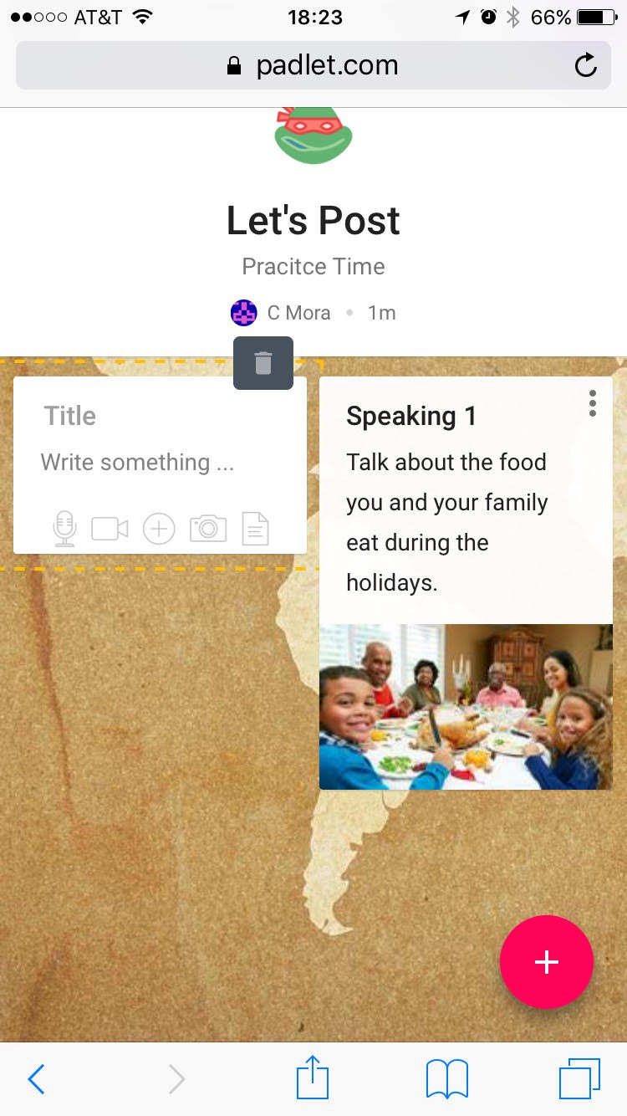
Padlet Posting
Post pictures, videos, and text
STEP 1

Slide 18
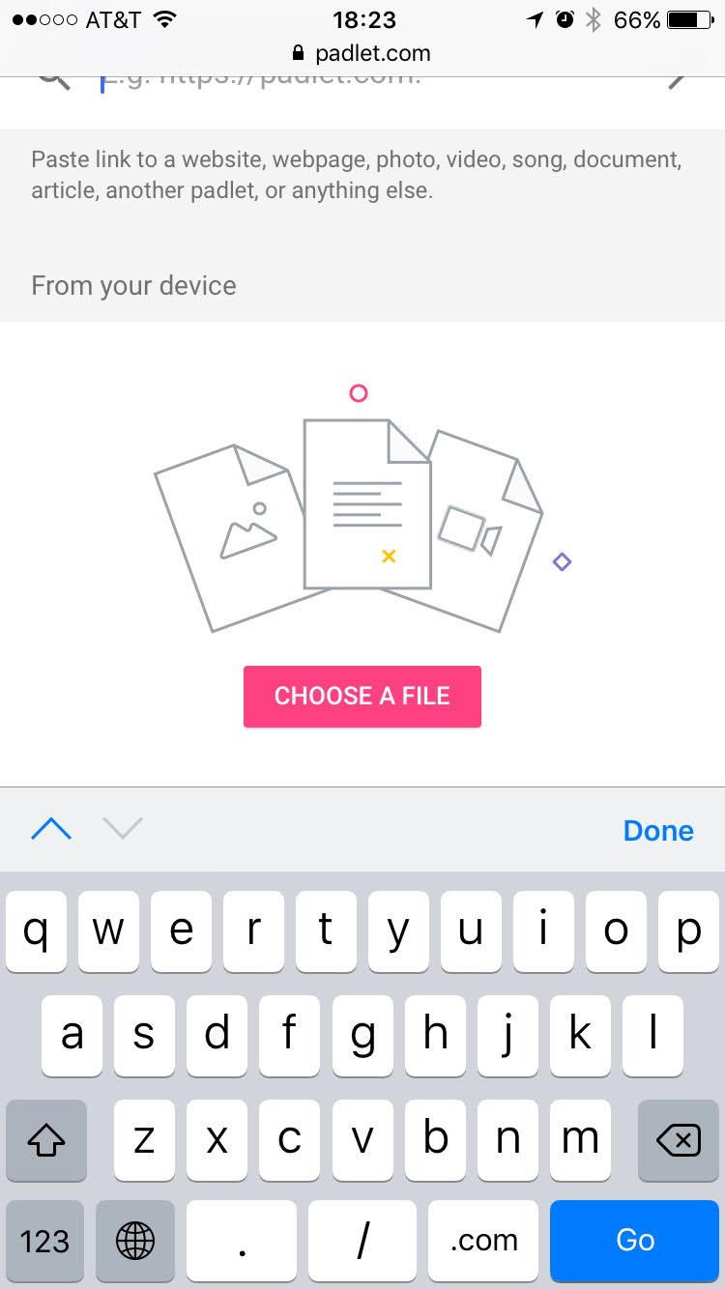
Padlet Posting
Post pictures, videos, and text
STEP 2

Slide 19
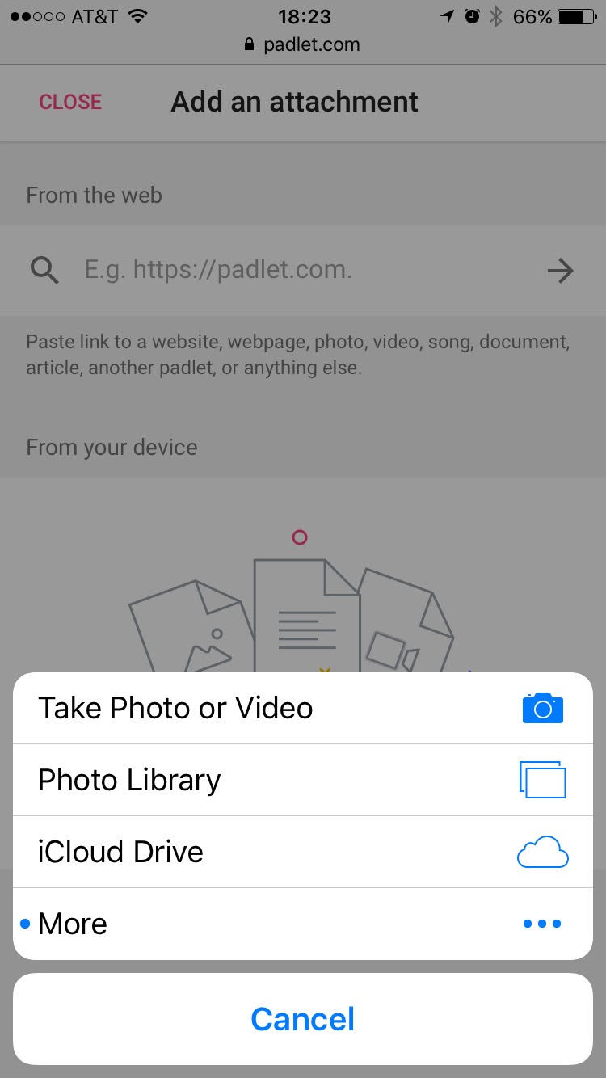
Padlet Posting
Post pictures, videos, and text
STEP 3

Slide 20
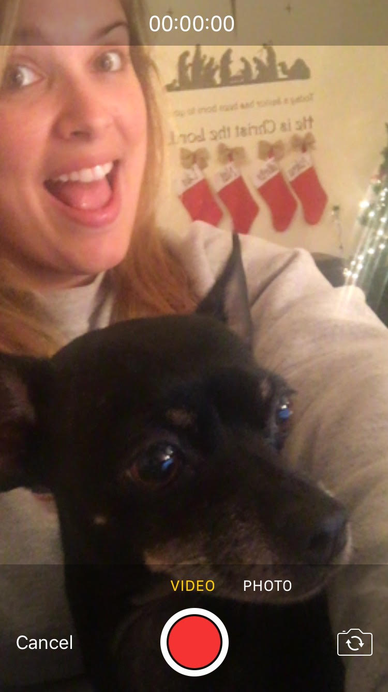
Padlet Posting
Post pictures, videos, and text
STEP 4

Slide 21
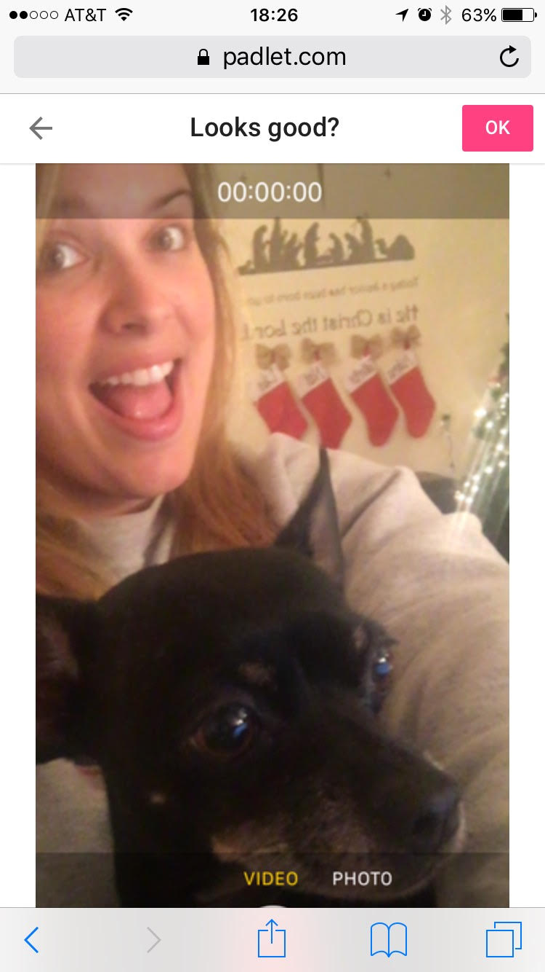
Padlet Posting
Post pictures, videos, and text
STEP 5

Slide 22
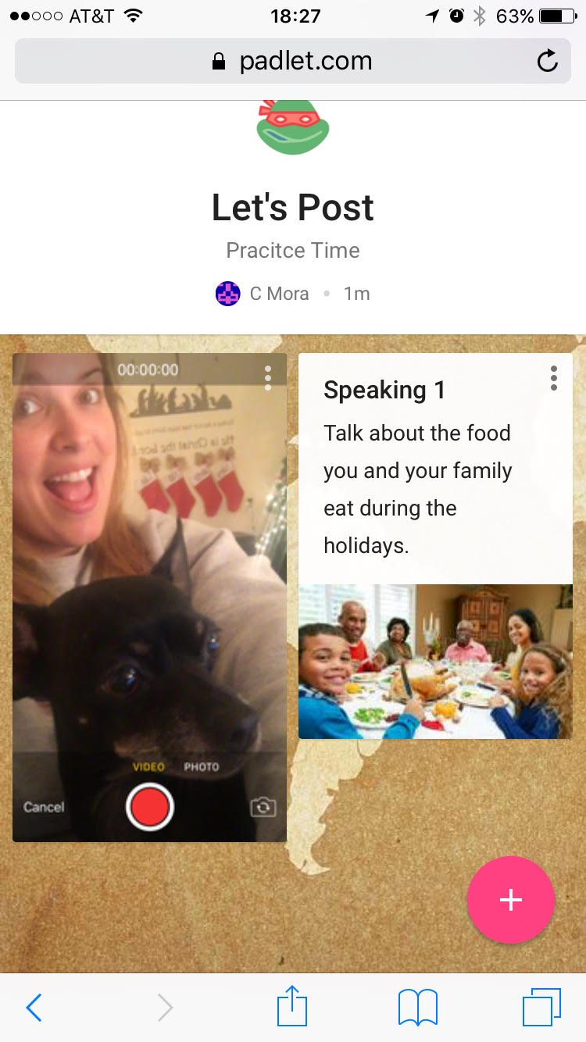
Padlet Posting
Post pictures, videos, and text
STEP 6

Slide 23
Padlet Posting
TRY IT!

Slide 24
Questions

Slide 25
Google Voice

Slide 26
Google Voice
Students can call, leave a message, or text.
All communication goes through email and/or app.
Not your real phone number

Slide 27
Google Voice-try it!
Call (206) 659-1763- introduce yourself and say what you like to do in your language

Slide 28
Questions

Slide 29
Other useful tech tool
Quizlet Live

Slide 30
Quizlet Live
Use an already created quizlet or one you’ve made for Quizlet Live
Student groups are made by programs
You can decide to allow groups to sit together or not
Only click the correct answer if you have it, only one person in each group will have the correct answer
Objective: first group to reach 12 points wins

Slide 31
Quizlet Live- try it!
Go to quizlet.live (NOT QUIZLET.COM)
Type in code-given after instructions
Write your name and wait for rest of class

Slide 32
Questions

Slide 33
Sharing is caring
Idea time!
Have you ever used any of these programs in your classes?
How can you use them other than what was discussed today?
Do you have any others to share?

